Slide 1
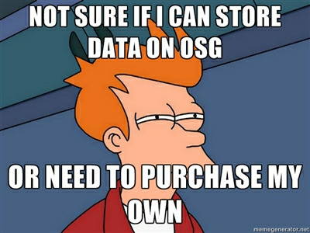
Distributed Storage Wednesday morning, 9:00am
Derek Weitzel <dweitzel@cse.unl.edu>
OSG Graduate Research Assistant
University of Nebraska – Lincoln

Slide 2

Who Am I?
PhD Graduate Student from Nebraska
Student of International Summer School for Grid Computing

Slide 3




Cloud Storage?
Has anyone used cloud storage before?

Slide 4
Why did you use cloud storage?
Why did you use Dropbox?
Sharing files with others?
Access to the files from anywhere (web)?
Not necessarily for storage, you still have to have a copy on your computer

Slide 5
What would Dropbox look like in Science?
Would Dropbox look the same in Science?
Do you want a copy of all your files on your computer, and some ‘Cloud’?
2 copies
Do you want it accessible from everywhere?

Slide 6
What would Dropbox look like in Science?
I think Dropbox would look different
Data is getting too big to have a ‘local’ copy on your desktop, and somewhere else.
Want the total dataset somewhere big, and well maintained (Cloud?)
Want only a working set on my desktop.

Slide 7
Outline
Common data patterns in HTC Applications.
Storage architecture for HTC sites
Strategies for Managing Data.
Reliability and the Cost of Complexity
Prestaging data on the OSG
Advanced Data Management Architectures

Slide 8
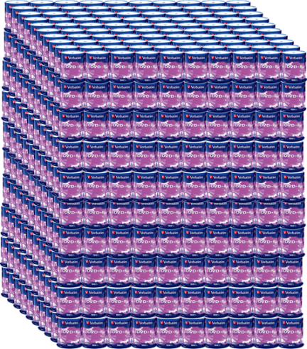
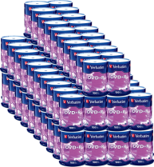

CMS Computing
Now
2000
1997
E917 5 TB/run
Phobos
50 TB/run
CMS
6 PB raw/run

Slide 9
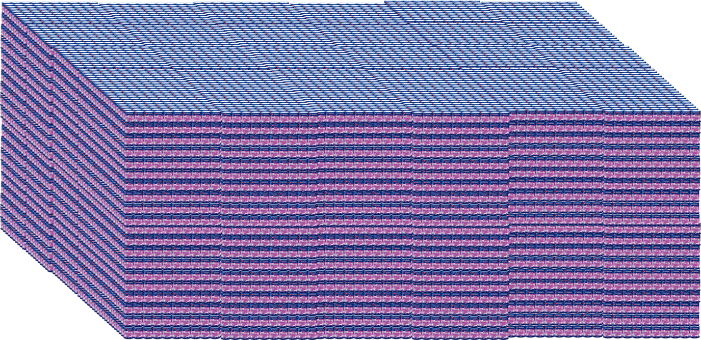


CMS Computing
Total needed data volume
on tape: 84 PB
E917
Phobos

Slide 10
Common Storage Patterns
There are many variations in how storage is handled.
Not only variations from different workflows, but even within a workflow
Important: Pick a proper storage strategy for you application!

Slide 11
Common Storage Patterns
I’m going to highlight a few of the storage patterns seen at HTC sites
It’s important to note that moving files around is relatively easy. Error cases are the hard part of storage management.

Slide 12
Classifying Usage
Ask yourself, per job:
Events in a job’s life:
INPUT: What should be available when the job is starting?
RUNTIME: What is needed while the job runs?
OUTPUT: What output is produced?
Important quantities:
FILES: How many files?
DATA: How big is the “working set” of data? How big is the sum of all the files?
RATES: How much data is consumed on average? At peak?

Slide 13
Why we care about quantities?
FILES: How many files?
Many file systems cannot handle lots of small files
DATA:
Working set is how much you need on a worker node for 1 ‘unit’ of work
How much space do you need on the file server to store the input? Output?

Slide 14
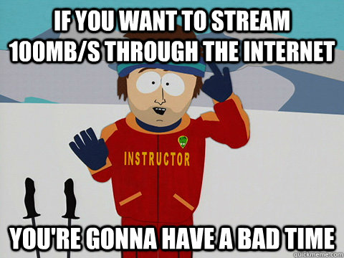
Why we care about quantities?
RATES: How much data is consumed on average? At peak?
Even professionals have a hard time figuring this out
Rates determine how you should stage your data (talk about staging shortly)

Slide 15
Examples of usage
Simulation
Small input, big out
Searches
Big input, small output
Data processing
~same input and output
Analysis
Big input, small output

Slide 16
Simulation
Based on different input configurations, generate the physical response of a system.
Input: The HTC application must manage many input files; one per job.
Runtime: An executable reads the input and later produces output. Sometimes, temporary scratch space is necessary for intermediate results.
Output: These outputs can be small [KB] (total energy and configuration of a single molecule) or large [GB] (electronic readout of a detector for hundreds of simulated particle collisions).
“Huge” outputs [TB] are currently not common in HTC.

Slide 17
Searches
Given a database, calculate a solution to a given problem.
Input: A database (possibly several GB) shared for all jobs, and an input file per job.
Runtime: Job reads the configuration file at startup, and accesses the database throughout the job’s runtime.
Output: Typically small (order of a few MB); the results of a query/search.

Slide 18
Data Processing
Transform dataset(s) into new dataset(s). The input dataset might be re-partitioned into new logical groupings, or changed into a different data format.
Input: Configuration file. Input dataset
Runtime: Configuration is read at startup; input dataset is read through, one file at a time. Scratch space used for staging output.
Output: Output dataset; similar in size to the input dataset.

Slide 19
Analysis
Given some dataset, analyze and summarize its contents.
Input: Configuration file and data set.
Runtime: Configuration file is read, then the process reads through the files in the dataset, one at a time (approximately constant rate). Intermediate output written to scratch area.
Output: Summary of dataset; smaller than input dataset.

Slide 20
OSG Anti-Patterns
Just as we want to identify common successful patterns, we want to identify common patterns that are unsuccessful on OSG.
Files larger than >5GB.
Requiring a (POSIX) shared file system.
Lots of small files (more than 1 file per minute of computation time).
Jobs consuming more than 10GB per hour, or needing scratch space more than 5GB.
Locking, appending, or updating files.
When using OSG resources opportunistically, the effective limitations may be more restrictive than above!

Slide 21
Exercise to help identify problems
Remember, we want to identify:
Input data – How much data is needed for the entire workflow?
Working set – How much data is needed to run 1 unit of work? Including possible temporary files.
Output data – How much data is output to the workflow.

Slide 22
Questions?
Questions? Comments?
Feel free to ask me questions:
Derek Weitzel <dweitzel@cse.unl.edu>
Upcoming sessions
9:30-10:15
Hands-on exercises
10:15 – 10:30
Break
10:30 – 12:00
More!

Slide 23

Exercise
https://opensciencegrid.org/bin/view/Education/OSGSS2013StorageEx1

Slide 24
Lecture 2: Using Remote Storage Systems
Derek Weitzel <dweitzel@cse.unl.edu>

Slide 25
Last Exercise
What where some of the numbers for the last exercise?

Slide 26
Last Exercise
Yeast:
Data: 22MB (executable = 15MB, why?)
Rate
MB/s = 22MB / .3s = 73MB/s
Files = 11 / .3s = 36/s
Compare:
Spinning disk = ~60MB/s

Slide 27
Storage Architectures on the OSG
Lets look at how storage is structured on the OSG
This will give you an idea of where the bottlenecks can be.
Also can help when forming data solutions on your own.

Slide 28
Storage at OSG CEs
All OSG sites have some kind of shared, POSIX-mounted storage (typically NFS).* This is almost never a distributed or high-performance file system
This is mounted and writable on the CE.*
This is readable (sometimes read-only) from the OSG worker nodes.
*Exceptions apply! Sites ultimately decide

Slide 29
Why Not?
This setup is called the “classic SE” setup, because this is how the grid worked circa 2003.
Why didn’t this work?
High-performance filesystems not reliable or cheap enough.
Scalability issues.
Difficult to manage space.

Slide 30
Storage Elements
In order to make storage and transfers scalable, sites set up a separate system for storage (the Storage Element).
Most sites have an attached SE, but there’s a wide range of scalability.
These are separated from the compute cluster; normally, you interact it via a get or put of the file.
Not POSIX!

Slide 31
Storage Elements on the OSG
User point of View!

Slide 32
SE Internals
Only care about

Slide 33
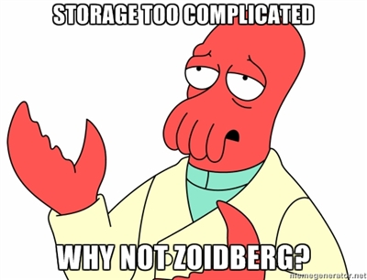
Complicated?

Slide 34
GridFTP in One Slide
An set of extensions to the classic FTP protocol.
Two most important extensions:
Security: Authentication, encryption, and integrity provided by GSI/X509. Use proxies instead of username/password.
Improved Scalability: Instead of transferring a file over one TCP connection, multiple TCP connections may be used.

Slide 35
SRM
SRM = Storage Resource Management
SRM is a web-services-based protocol for doing:
Metadata Operations.
Load-balancing.
Space management.
This allows us to access storage remotely, and to treat multiple storage implementations in a homogeneous manner.

Slide 36
Data Access Methods
To go with our archetypical problems, we’ll have a few common approaches to implementing solutions:
Job Sandbox
Prestaging
Caching
Remote I/O
A realistic solution will combine multiple methods.
Descriptions to follow discuss the common case; there are always exceptions or alternates.

Slide 37
Job Sandbox
Data sent with jobs.
The user generates the files on the submit machines.
These files are copied from submit node to worker node.
With Condor, a job won’t even start if the sandbox can’t be copied first. You can always assume it is found locally.
What are the drawbacks of the job sandbox?

Slide 38
Prestaging
Data placed into some place “near” to where the jobs are run.
By increasing the number of locations of the data and doing intelligent placement, we increase scalability.
In some cases, prestaging = making a copy at each site where the job is run.
Not always true; a single storage element may be able to support the load of many sites.

Slide 39
Caching
A cache transparently stores data close to the user process. Future requests can be served from the cache.
User must place file/object at a source site responsible for keeping the file permanently. Cache must be able to access the file at its source.
Requesting a file will bring it into the cache.
Once the cache becomes full, an eviction policy is invoked to decide what files to remove.
The cache, not the user, decides what files will be kept in the cache.

Slide 40
Remote I/O
Application data is streamed from a remote site upon demand. I/O calls are transformed into network transfers.
Typically, only the requested bytes are moved.
Often, data is streamed from a common source site.
Can be done transparently so the user application doesn’t know the I/O isn’t local.
Can be effectively combined with caching to scale better.

Slide 41
Scalability
For each of the four previous methods (sandboxes, prestaging, caching, remote I/O), how well do they scale?
What are the limitations on data size?
What resources are consumed per user-process?
What are the scalability bottlenecks?

Slide 42
The Cost of Reliability
For each of the four previous methods, what must be done to create a reliable system?
What’s the cost for tracking the location of files?
What recovery must be done on failures?
What must be done manually, or require extra infrastructure?
What is the most critical bottlenecks or points of failure?
How do these tie into the job submission system?

Slide 43
Comparing Compute and Storage
The “shared resource” for computing is the gatekeeper.
One badly behaving user can overload the gatekeeper, preventing new jobs from starting.
However, once jobs are started, they are mostly independent.
There are some shared aspects: what are they? Why am I not concerned about them?

Slide 44
Comparing Compute and Storage
Storage is different:
It is often used throughout the job’s lifetime, especially for remote I/O.
One badly behaved user can crash the storage resource – or at least severely degrade.
Opportunistic usage of storage via prestaging does not automatically have a limited lifetime.
Most users assume that data, once written to a SE, will be retrievable.

Slide 45
Prestaging Data on the OSG
Prestaging is currently the most popular data management method on the OSG, but requires the most work.
Requires a transfer system to move a list of files between two sites. Example systems: Globus Online, Stork, FTS.
Requires a bookkeeping system to record the location of datasets. Examples: LFC, DBS.
Requires a mechanism to verify the current validity of file locations in the bookkeeping systems. Most systems are ad-hoc or manual.

Slide 46
Previous example?
In the first exercise, you formulated a data plan for BLAST.
Now, you are going to implement the data movement of blast using pre-staging.

Slide 47
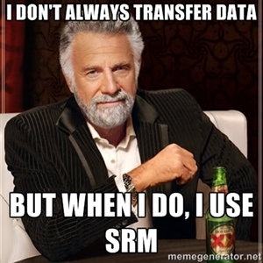
Exercise Time!
https://twiki.grid.iu.edu/bin/view/Education/OSGSS2013StorageEx2

Slide 48
Lecture 3: Caching and Remote I/O
Derek Weitzel <dweitzel@cse.unl.edu>

Slide 49
HTTP Caching is easy on the OSG
Widely deployed caching servers (required by other experiments)
Tools are easy to use
curl, wget
Servers are easy to setup
Just need http server, somewhere

Slide 50
HTTP Caching
In practice, you can cache almost any URL
Site caches are typically configured to cache any URL, but only accept requests from WN’s
Sites control the size and policy for caches, keep this in mind.

Slide 51
HTTP Caching - Pitfalls
curl – Have to add special argument to use caching:
curl -H "Pragma:” <url>
Services like Dropbox and Google Docs explicitly disable caching
Dropbox: cache-control: max-age=0
Google Docs: Cache-Control: private, max-age=0
They also use uncachable HTTPS

Slide 52
HTTP Caching
The HTTP protocol is perhaps the most popular application-layer protocol on the planet.
Built-in to HTTP 1.1 are elaborate mechanisms to use HTTP through a proxy and for caching.
There are mature, widely-used command-line clients for the HTTP protocol on Linux.
Curl and wget are the most popular; we will use wget for the exercises.
Oddly enough, curl disables caching by default.

Slide 53
HTTP Caching: What do you need?
All you need is a public webserver… somewhere.
Will pull down files to the worker node through squid cache.

Slide 54
HTTP Cache Dataflow
For this class, we will use:
Source site: osg-ss-submit.chtc.wisc.edu
HTTP cache: osg-ss-se.chtc.wisc.edu

Slide 55
Proxy Request
Here’s the HTTP headers for the request that goes to the proxy osg-ss-se.cs.wisc.edu:
GET http://osg-ss-submit.chtc.wisc.edu/~dweitzel/stuff.html HTTP/1.0
User-Agent: Wget/1.11.4 Red Hat modified
Accept: */*
Host: osg-ss-submit.chtc.wisc.edu

Slide 56
Proxy Request
Response:
HTTP/1.0 200 OK
Date: Tue, 19 Jun 2012 22:53:26 GMT
Server: Apache/2.2.3 (Scientific Linux)
Last-Modified: Tue, 19 Jun 2012 21:26:56 GMT
ETag: "136d0f-59-4c2d9f120e800"
Accept-Ranges: bytes
Content-Length: 89
Content-Type: text/html; charset=UTF-8
X-Cache: HIT from osg-ss-se.chtc.wisc.edu
X-Cache-Lookup: HIT from osg-ss-se.chtc.wisc.edu:3128
Via: 1.0 osg-ss-se.chtc.wisc.edu:3128 (squid/2.6.STABLE21)
Proxy-Connection: close

Slide 57
HTTP Proxy
HTTP Proxy is very popular for small VO’s
Easy to manage, easy to implement
Highly recommend HTTP Proxy for files less than 100MB.

Slide 58
Now on to Remote I/O
Do you only read parts of the data (skip around in the file?)
Do you have data that is only available on the submit host?
Do you have an application that requires a specific directory structure?

Slide 59

Remote I/O is for you

Slide 60
Remote I/O

Slide 61

Remote I/O
We will perform Remote I/O with the help of Parrot from ND.
It redirects I/O requests back to the submit host.
Can ‘pretend’ that a directory is locally accessible.

Slide 62
Examples of Remote I/O
What does Remote IO look like in practice?
submit host:
$ echo “hello from submit host” > newfile
script on the worker node (in Nebraska?)
$ cat /chirp/CONDOR/home/dweitzel/newfile
hello from submit host
$

Slide 63
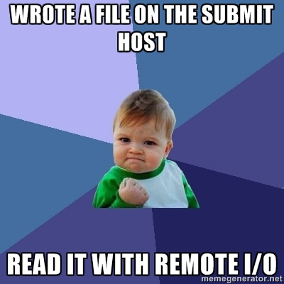
Celebrate!

Slide 64
Downsides of Remote I/O
What are some downsides to Remote I/O?
All I/O goes through the submit host.
Distributed remote I/O is hard (though can be done, see XrootD)

Slide 65
Now lets do it!
https://twiki.grid.iu.edu/bin/view/Education/OSGSS2013StorageEx3

